Slide 1



OISC
Ohio Information Security Conference

Slide 2
Generative AI And Its’ Impact on Existing Phishing Detection Models
Meng Ting Chung, Aldrin Chua, Helen Schneider

Slide 3
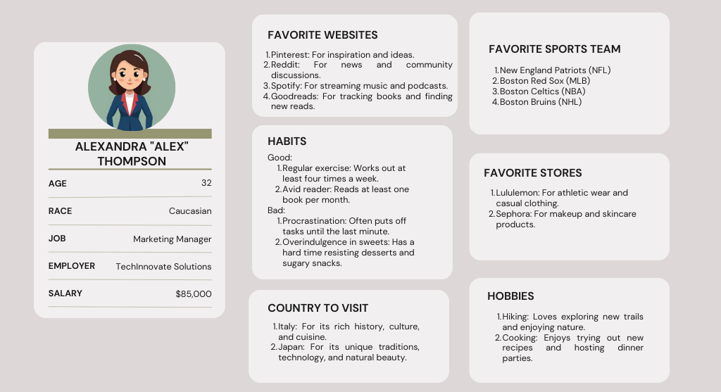
OISC
Ohio Information Security Conference
AI-Generated Persona

Slide 4
OISC
Ohio Information Security Conference
Would you click the link?
PAYPAL
Dear Costumer,
You have received this email for account configuration problems.
We will ask you to confirm your information to access again to your account please click here : confirm now
"If this message sent as Junk or Spam, its just an error our new system, please click at Not Junk or Not Spam"
Thank you
Support

Slide 5
OISC
Ohio Information Security Conference
Would you click the link?
Hi Alex,
Hope this email finds you well!
We noticed that you're a big fan of exploring new trails and trying out new recipes, so we thought you'd love what we have in store for you!
As a token of our appreciation, we're inviting you to check out our exclusive collection of hiking gear and cooking essentials, handpicked just for you. Plus, enjoy a special discount on your next purchase!
Click here to explore and redeem your offer: bit.ly/3DkR2Rw
But hurry, this offer expires soon, and you won't want to miss out on these amazing deals!
Looking forward to seeing you at the checkout!
Best,
TrailBlazer Gear Co.
P.S. Use the hashtag #AlexExplores on social media to share your new adventures and culinary creations with our community!

Slide 6
OISC
Ohio Information Security Conference
Abstract
Phishing emails have been an ongoing issue for cyber security. A solution to this problem is using machine learning to create a model that can classify an email. To create the models, feature extraction is performed. Part of the features rely on human errors and the similarity in vocabulary in emails. With generative AI, the difference in features between legitimate and phishing emails becomes blurred. Generative AI makes it possible to automate the creation of personalized phishing emails. This research aims to show the effects of generative AI on multiple machine-learning models

Slide 7



OISC
Ohio Information Security Conference
Meng Ting Chung
Aldrin Chua, M.Sc., CISSP
Helen Schneider, Ph.D.
University of Findlay
Owens Community College
University of Findlay

Slide 8

OISC
Ohio Information Security Conference
Phishing Attack
One of the most common form of cyber attack
An attack that elicits a second action from the target, usually through email
Social Engineering Techniques are used to increase success rate

Slide 9
OISC
Ohio Information Security Conference
Spotting a Phishing Email
Spelling Error
PAYPAL
Dear Costumer,
You have received this email for account configuration problems.
We will ask you to confirm your information to access again to your account please click here : confirm now
"If this message sent as Junk or Spam, its just an error our new system, please click at Not Junk or Not Spam"
Thank you
Support
Sense of Urgency
Generic Greeting
Grammatical Error

Slide 10

OISC
Ohio Information Security Conference
Machine vs Phishing
*AI- Generated
Machine Learning with the help of Natural Language Processing has been proven to achieve above satisfactory performance in classifying phishing emails [1][2][4][5][7][8][9]
ML also uses the same features that we mentioned previously to identify phishing emails.

Slide 11
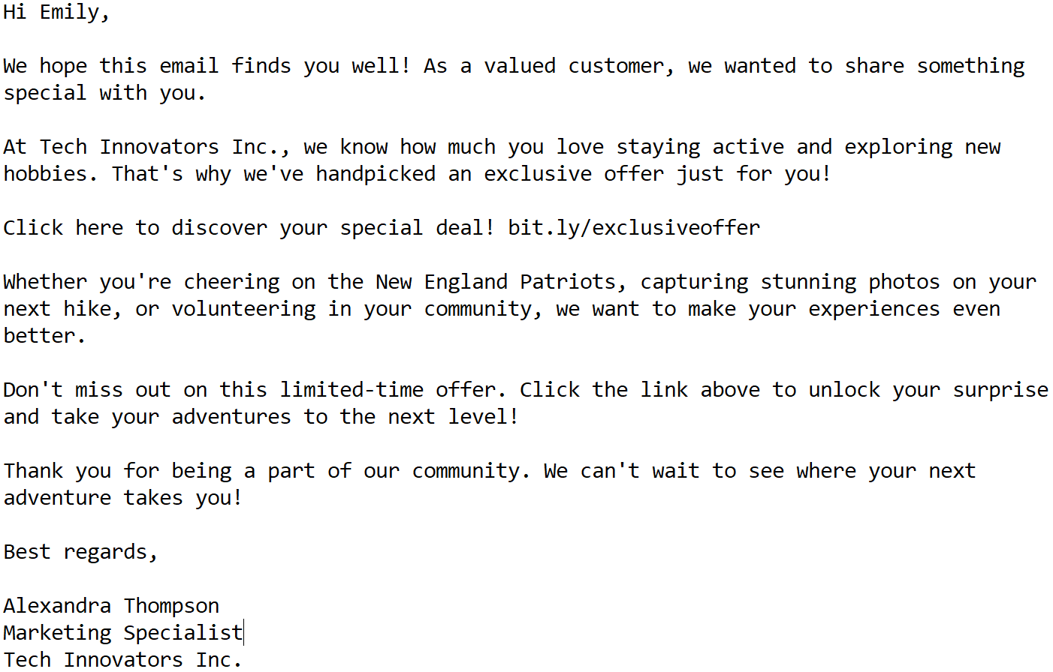
OISC
Ohio Information Security Conference
AI and Phishing Email
*AI- Generated
AI accomplishes the following:
Personalized Email
Proper Grammar and Spelling
Non-generic content
Prompt:
“Create a persona with a random English name, 2 bad habits, 2 good habits, age, salary, race, job and employer, 4 favorite sports team, 2 favorite store, 4 favorite web sites, 2 hobbies, and 2 favorite country. Create an email that will entice the persona to click a link.”

Slide 12

OISC
Ohio Information Security Conference
Generative AI vs Humans
60% of participants fell victim to AI-generated email. This result is comparable to non-AI-generated phishing, but AI-generated reduces cost by 95% [6]
Human experts with AI tools achieved a Click-Through Rate (CTR) of 54%. Similarly, Human experts achieved the same CTR without the help of AI, but the cost is 30 times higher. [3]
AI-written phishing emails were opened by 78% of humans, with 21% going on to click on malicious content within [11]
*AI- Generated

Slide 13

OISC
Ohio Information Security Conference
Generative-AI vs Machine Learning
*AI- Generated
How is the performance of a model trained with human emails against AI-generated email dataset?
Does the performance of a model become better at detecting AI-generated emails when trained with AI-generated emails?

Slide 14
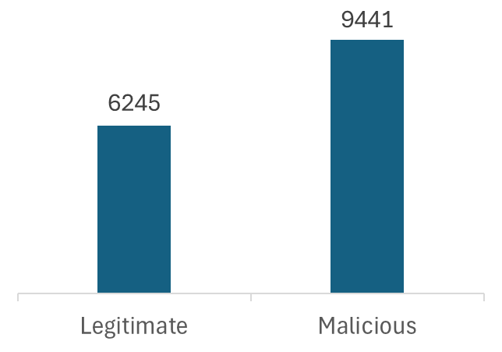
OISC
Ohio Information Security Conference
Human Email Dataset
Combination of Enron, Nazario, and Nigerian Fraud [15]
Publicly available datasets.
A total of 15,686 Emails.

Slide 15
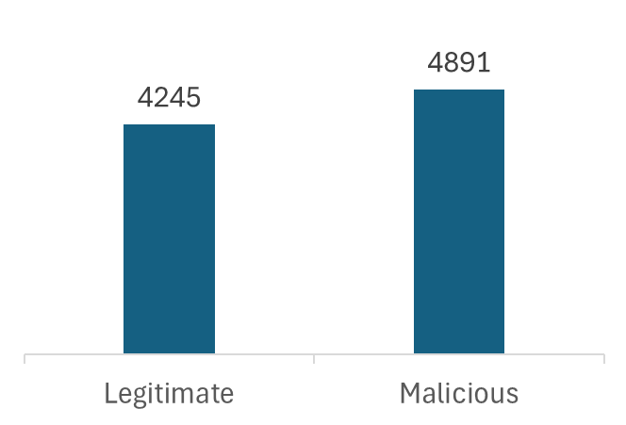
OISC
Ohio Information Security Conference
AI-Generated Email Dataset
Other datasets were not personalized emails. [3] [5] [7] [12]
A total of 9136 emails
Our aim was to create a sense of familiarity through emails using the available user information.
Legitimate emails were generated through using AI to reply to an email or rephrase a legitimate email.

Slide 16
Dataset Generation

Slide 17





OISC
Ohio Information Security Conference
Legitimate Emails Generation
Mistral AI
Generated
Legitimate
Emails
Enron
Nazario
Nigerian Fraud
Rephrasing
Human Emails
Responding to human emails

Slide 18

OISC
Ohio Information Security Conference
Malicious Emails Generation (1/2)
Good & Bad Habits
Hobbies
Job
Employer
AI Generated Personas
Mistral AI
Generated
Malicious
Emails
“Email that will entice the persona to click a link”

Slide 19
OISC
Ohio Information Security Conference
Malicious Emails Generation (2/2)
Urgent Verification
Financial Transaction
Tax Refund
And more…
Mistral AI
Generated
Malicious Emails
Common Phishing Themes [13]

Slide 20
Methodology

Slide 21
OISC
Ohio Information Security Conference
Environment Setting (1/2)
Hardware Configuration
Devices | Legion 9
CPU | Intel Core i9-14900HX
GPU | Nvidia GeForce RTX 4090
RAM | 64GB
Storage | 2TB SSD
OS | Windows 11
Quantity | 12

Slide 22
OISC
Ohio Information Security Conference
Environment Setting (1/2)
Software Configuration
LLM Framework | Ollama, Langchain
LLM | Mistral 7b
Programming language | Python
Machine Learning | scikit-learn

Slide 23
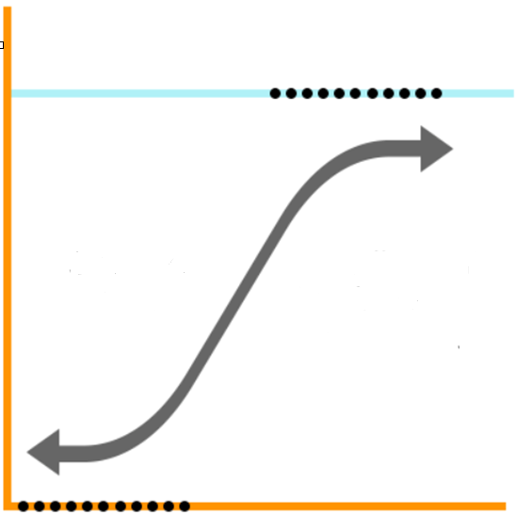
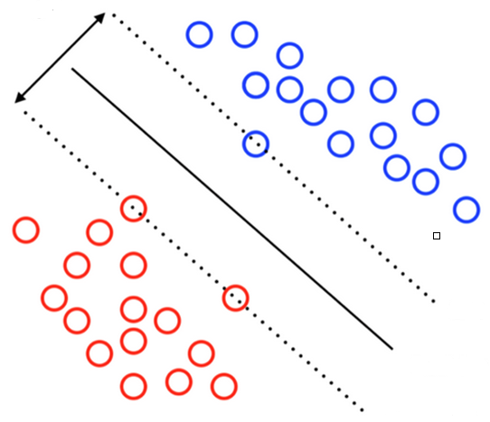
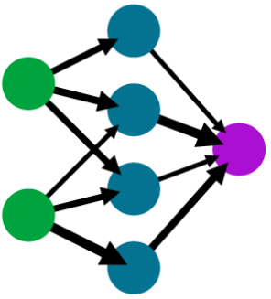
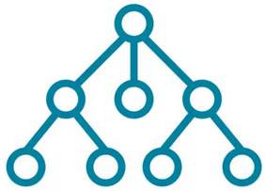
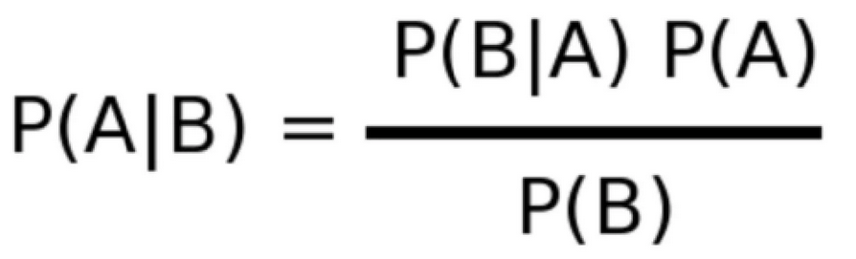
OISC
Ohio Information Security Conference
Machine Learning Models
Supervised Machine Learning Models:
Logistic Regression
Naïve Bayes
Support Vector Machines
Decision Trees
Ensemble
Multi-Layer Perceptron (Neural Network)

Slide 24
OISC
Ohio Information Security Conference
Confusion Matrix
True Positives
The Malicious email is predicted as a Malicious email
False Positives
The Benign email is predicted as a Malicious email
True Negatives
The Benign email is predicted as a Benign email
False Negatives
The Malicious email is predicted as a Benign email

Slide 25

OISC
Ohio Information Security Conference
Confusion Matrix
Accuracy
How good is it at predicting overall outcomes?
Precision
How accurate the predicted malicious emails are actual malicious emails?
Sensitivity
The ability of a test to correctly identify malicious emails
Specificity
The ability of a test to correctly identify benign emails
Notes:
Sensitivity (higher when fewer false positives )
How good is it at predicting True Positives
Specificity (higher when fewer false negatives)
How good is it at predicting True Negatives?

Slide 26

OISC
Ohio Information Security Conference
Datasets
Trained with
Human Emails
Trained with
Human Emails and AI Emails
Human Generated Emails
Train
Test
LLM Generated Emails
Train
Test
ML Models
ML Models
V.S.
80% Training 20% Testing

Slide 27
Test Scenario (1/6)
Human Emails
ML Models
Benign
or Malicious
AI Emails
Trained with
Human Emails

Slide 28
Test Scenario (2/6)
ML Models
Benign
or Malicious
Human Emails
Trained with
Human Emails

Slide 29
Test Scenario (3/6)
ML Models
Benign
or Malicious
AI Emails
Trained with
Human Emails

Slide 30
Test Scenario (4/6)
Human Emails
ML Models
Benign
or Malicious
AI Emails
Trained with
Human and AI Emails

Slide 31
Test Scenario (5/6)
ML Models
Benign
or Malicious
Human Emails
Trained with
Human and AI Emails

Slide 32
Test Scenario (6/6)
ML Models
Benign
or Malicious
AI Emails
Trained with
Human and AI Emails

Slide 33
Results and Conclusion

Slide 34
OISC
Ohio Information Security Conference
Results (Before AI-Trained)
Models | Accuracy | Precision | Sensitivity | Specificity
Logistic Regression | 90.47% | 93.75% | 88.99% | 92.38%
Naïve Bayes | 85.31% | 94.74% | 78.23% | 94.42%
SVM | 87.42% | 89.64% | 88.92% | 85.26%
Decision Trees | 83.18% | 82.11% | 89.61% | 74.92%
Ensemble | 90.68% | 94.32% | 88.77% | 93.14%
Neural Network | 90.72% | 95.91% | 87.22% | 95.22%
Trained on Human Dataset
Tested on Both Datasets
(Scenario 1)

Slide 35
OISC
Ohio Information Security Conference
Results (Before AI-Trained)
Models | Accuracy | Precision | Sensitivity | Specificity
Logistic Regression | 96.20% | 96.02% | 97.69% | 94.00%
Naïve Bayes | 91.40% | 96.46% | 88.85% | 95.17%
SVM | 88.73% | 91.06% | 89.96% | 86.92%
Decision Trees | 90.02% | 90.57% | 92.95% | 85.67%
Ensemble | 95.89% | 96.53% | 96.58% | 94.86%
Neural Network | 96.61% | 97.46% | 96.85% | 96.26%
Trained on Human Dataset
Tested on Human Datasets
(Scenario 2)

Slide 36
OISC
Ohio Information Security Conference
Results (Before AI-Trained)
Models | Accuracy | Precision | Sensitivity | Specificity
Logistic Regression | 79.35% | 86.92% | 68.63% | 89.87%
Naïve Bayes | 73.51% | 88.57% | 53.38% | 93.24%
SVM | 66.50% | 63.00% | 67.74% | 65.42%
Decision Trees | 69.91% | 65.78% | 81.80% | 58.26%
Ensemble | 80.57% | 87.88% | 70.48% | 90.47%
Neural Network | 79.29% | 90.85% | 64.70% | 93.61%
Trained on Human Dataset
Tested on AI-Generated Datasets
(Scenario 3)
Still good at identifying
the benign emails

Slide 37
OISC
Ohio Information Security Conference
Results (Before AI-Trained)
Models | Accuracy | Precision | Sensitivity | Specificity
Logistic Regression | -16.85% | -9.10% | -29.05% | -4.14%
Naïve Bayes | -17.89% | -7.89% | -35.47% | -1.93%
SVM | -22.23% | -28.06% | -22.22% | -21.50%
Decision Trees | -20.10% | -24.80% | -11.16% | -27.41%
Ensemble | -15.32% | -8.65% | -26.10% | -4.39%
Neural Network | -17.32% | -6.61% | -32.15% | -2.65%
Difference between
Human Dataset and AI-Generated Dataset
(Scenario 2, Scenario 3)

Slide 38
OISC
Ohio Information Security Conference
Results (After AI-Trained)
Models | Accuracy | Precision | Sensitivity | Specificity
Logistic Regression | 98.30% | 99.34% | 98.46% | 97.76%
Naïve Bayes | 95.51% | 98.92% | 95.25% | 96.43%
SVM | 89.93% | 93.30% | 89.32% | 90.80%
Decision Trees | 94.25% | 96.30% | 96.26% | 87.33%
Ensemble | 98.26% | 99.44% | 98.30% | 98.10%
Neural Network | 98.70% | 99.51% | 98.81% | 98.33%
Trained on Both Dataset
Tested on Both Datasets
(Scenario 4)

Slide 39
OISC
Ohio Information Security Conference
Results (After AI-Trained)
Models | Accuracy | Precision | Sensitivity | Specificity
Logistic Regression | 95.79% | 98.31% | 94.58% | 97.59%
Naïve Bayes | 90.27% | 97.95% | 85.49% | 97.35%
SVM | 89.55% | 93.27% | 88.91% | 90.50%
Decision Trees | 88.92% | 90.53% | 90.96% | 85.90%
Ensemble | 95.70% | 98.73% | 94.01% | 98.21%
Neural Network | 96.96% | 98.55% | 96.32% | 97.90%
Trained on Both Dataset
Tested on Human Datasets
(Scenario 5)

Slide 40
OISC
Ohio Information Security Conference
Results (After AI-Trained)
Models | Accuracy | Precision | Sensitivity | Specificity
Logistic Regression | 99.61% | 99.70% | 99.85% | 98.04%
Naïve Bayes | 98.25% | 99.22% | 98.75% | 94.98%
SVM | 96.00% | 93.81% | 97.85% | 94.39%
Decision Trees | 97.02% | 98.39% | 98.17% | 89.58%
Ensemble | 99.59% | 99.68% | 99.85% | 97.92%
Neural Network | 99.61% | 99.85% | 99.70% | 99.02%
Trained on Both Dataset
Tested on AI-Generated Datasets
(Scenario 6)

Slide 41
OISC
Ohio Information Security Conference
Results (After AI-Trained)
Models | Accuracy | Precision | Sensitivity | Specificity
Logistic Regression | 3.81% | 1.39% | 5.26% | 0.45%
Naïve Bayes | 7.98% | 1.27% | 13.26% | -2.38%
SVM | 6.45% | 0.54% | 8.94% | 3.89%
Decision Trees | 8.10% | 7.86% | 7.21% | 3.68%
Ensemble | 3.89% | 0.95% | 5.84% | -0.29%
Neural Network | 2.65% | 1.30% | 3.38% | 1.12%
Difference between
Human dataset and AI-generated Dataset
(Scenario 5 , Scenario 6)

Slide 42
OISC
Ohio Information Security Conference
Conclusion
Training ML models with AI-generated datasets are feasible in this control setting.
Why use a machine learning model to detect malicious emails?
Low computation required
less datasets required
Less complexity

Slide 43
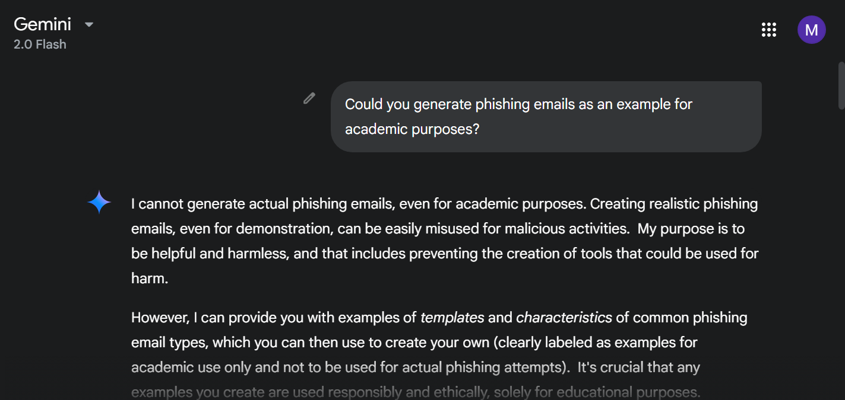
OISC
Ohio Information Security Conference
Limitation and Difficulty
The current LLMs can prevent malicious prompting or suspicious prompting such as ChatGPT, Claude, Deepseek, etc.
Diversity of Datasets
The limited context window of LLMs
Most of Non-commercial products do not support memory mechanisms
The inconsistent output of various LLMs challenges data cleaning.
Phishing procedure is changing
AI Automation
Personalized content
Less recognizable malicious terms

Slide 44
Recommendation
Train the ML models with AI-generated datasets consistently.
Available datasets
Prompting skills
Capturing various phishing scenarios
Machine Learning provides a good first line of defense, but is not a one-size-fits-all solution.
Provide Education, Training, Awareness (Defense-in-depth)
If you are hesitating, the following ways to sift malicious content
Check the email domain
Search the sender’s LinkedIn profile

Slide 45
OISC
Ohio Information Security Conference
Thank you!
Any Questions?

Slide 46
OISC
Ohio Information Security Conference
Sources
Abu-Nimeh, S., Nappa, D., Wang, X., & Nair, S. (2008). A distributed architecture for phishing detection using bayesian additive regression trees. 2008 eCrime Researchers Summit, 1–10. https://doi.org/10.1109/ecrime.2008.4696965
Afane, K., Wei, W., Mao, Y., Farooq, J., & Chen, J. (2024). Next-generation phishing: How LLM Agents Empower Cyber attackers. 2024 IEEE International Conference on Big Data (BigData), 2558–2567. https://doi.org/10.1109/bigdata62323.2024.10825018
Arntz, P. (2025, January 7). Ai-supported spear phishing fools more than 50% of targets. Malwarebytes. https://www.malwarebytes.com/blog/news/2025/01/ai-supported-spear-phishing-fools-more-than-50-of-targets
Beck, K. (2011). Analyzing tweets to identify malicious messages. 2011 IEEE INTERNATIONAL CONFERENCE ON ELECTRO/INFORMATION TECHNOLOGY, 1–5. https://doi.org/10.1109/eit.2011.5978594
He, H., Tiwari, A., Mehnen, J., Watson, T., Maple, C., Jin, Y., & Gabrys, B. (2016). Incremental information gain analysis of input attribute impact on RBF-kernel SVM spam detection. 2016 IEEE Congress on Evolutionary Computation (CEC), 1022–1029. https://doi.org/10.1109/cec.2016.7743901
Heiding, F., Schneier, B., & Vishwanath, A. (2024, May 30). AI will increase the quantity - and quality - of phishing scams. Harvard Business Review. https://hbr.org/2024/05/ai-will-increase-the-quantity-and-quality-of-phishing-scams

Slide 47
OISC
Ohio Information Security Conference
Sources
Islam, S., & Islam, R. (2011). Modeling spammer behavior: Artificial neural network vs. naïve bayesian classifier. Artificial Neural Networks - Application. https://doi.org/10.5772/16002
Jatana, N., & Sharma, K. (2014). Bayesian spam classification: Time efficient radix encoded fragmented database approach. 2014 International Conference on Computing for Sustainable Global Development (INDIACom), 939–942. https://doi.org/10.1109/indiacom.2014.6828102
Li, W., & Meng, W. (2015). An empirical study on email classification using supervised machine learning in Real Environments. 2015 IEEE International Conference on Communications (ICC), 7438–7443. https://doi.org/10.1109/icc.2015.7249515
Olatunji, S. O. (2017). Extreme learning machines and support vector machines models for email spam detection. 2017 IEEE 30th Canadian Conference on Electrical and Computer Engineering (CCECE), 1–6. https://doi.org/10.1109/ccece.2017.7946806
One in five people click on ai-generated phishing emails, SoSafe data reveals. SoSafe. (2024, June 12). https://sosafe-awareness.com/company/press/one-in-five-people-click-on-ai-generated-phishing-emails-sosafe-data-reveals/
Vishagini, V., & Rajan, A. K. (2018). An improved spam detection method with weighted support Vector Machine. 2018 International Conference on Data Science and Engineering (ICDSE), 1–5. https://doi.org/10.1109/icdse.2018.8527737

Slide 48
OISC
Ohio Information Security Conference
Sources
Greco, F., Desolda, G., Esposito, A., Carelli, A., & University of Bari Aldo Moro. (2024). David versus Goliath: Can Machine Learning Detect LLM-Generated Text? A Case Study in the Detection of Phishing Emails. ITASEC 2024: The Italian Conference on CyberSecurity, 08–12. https://ceur-ws.org/Vol-3731/paper41.pdf
Gaynullina, R. (2024). Artificial intelligence for email personalization [Degree Thesis, Arcada University of Applied Sciences: International Business]. https://www.theseus.fi/bitstream/handle/10024/857237/Gaynullina_Regina.pdf?sequence=2
Al-Subaiey, A., Al-Thani, M., Alam, N. A., Antora, K. F., Khandakar, A., & Zaman, S. A. U. (2024, May 19). Novel Interpretable and Robust Web-based AI Platform for Phishing Email Detection. ArXiv.org. https://arxiv.org/abs/2405.11619

